Slide 1
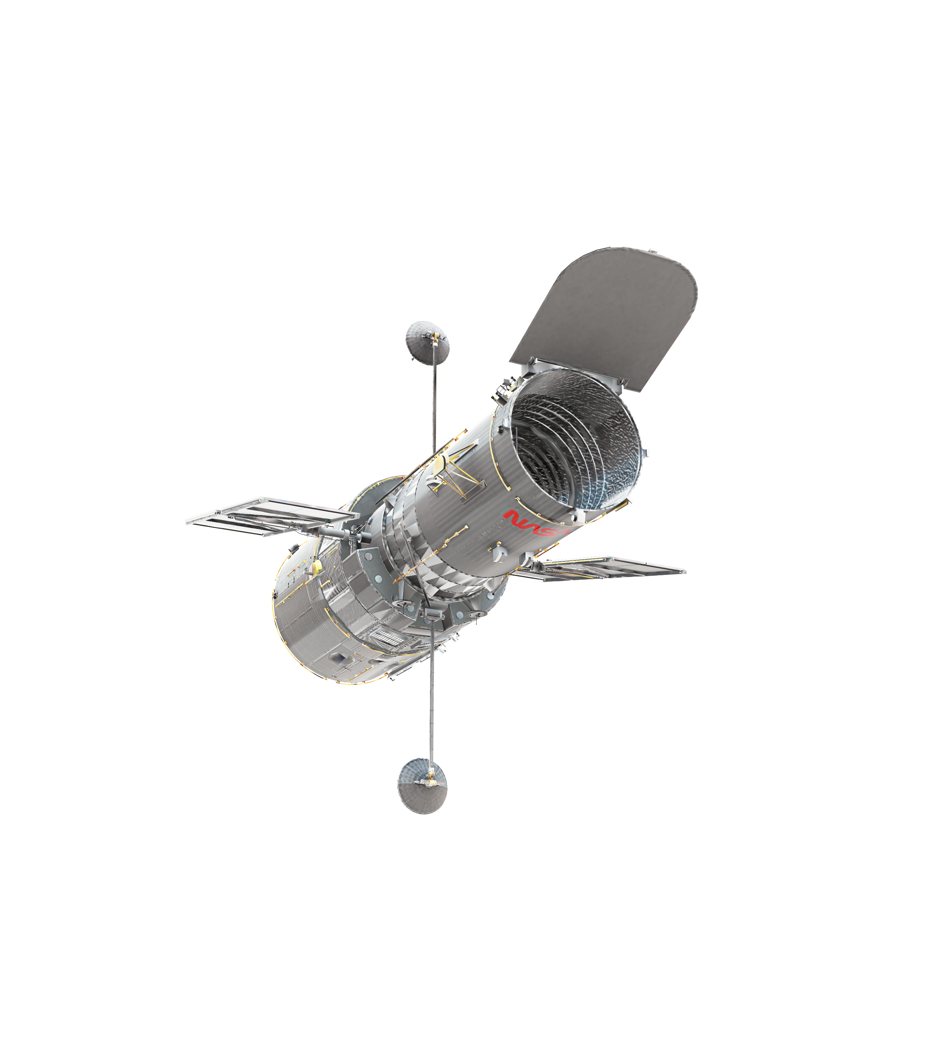
Data Science Capstone Project Report:
https://github.com/Selmabanzema/Data-Science-Capston-Project-
https://github.com/Selmabanzema/Data-Science-Capston-Project-/blob/main/jupyter-labs-webscraping.ipynb
https://github.com/Selmabanzema/Data-Science-Capston-Project-/blob/main/labs-jupyter-spacex-Data%20wrangling.ipynb
https://github.com/Selmabanzema/Data-Science-Capston-Project-/blob/main/jupyter-labs-eda-sql-coursera_sqllite.ipynb
https://github.com/Selmabanzema/Data-Science-Capston-Project-/blob/main/SpaceX_Machine%20Learning%20Prediction_Part_5%20(1).ipynb
https://github.com/Selmabanzema/Data-Science-Capston-Project-/blob/main/creating%20a%20dash.py
https://github.com/Selmabanzema/Data-Science-Capston-Project-/blob/main/edadataviz.ipynb
https://github.com/Selmabanzema/Data-Science-Capston-Project-/blob/main/lab_jupyter_launch_site_location.ipynb
Auther: Selma Kinacioglu

Slide 2
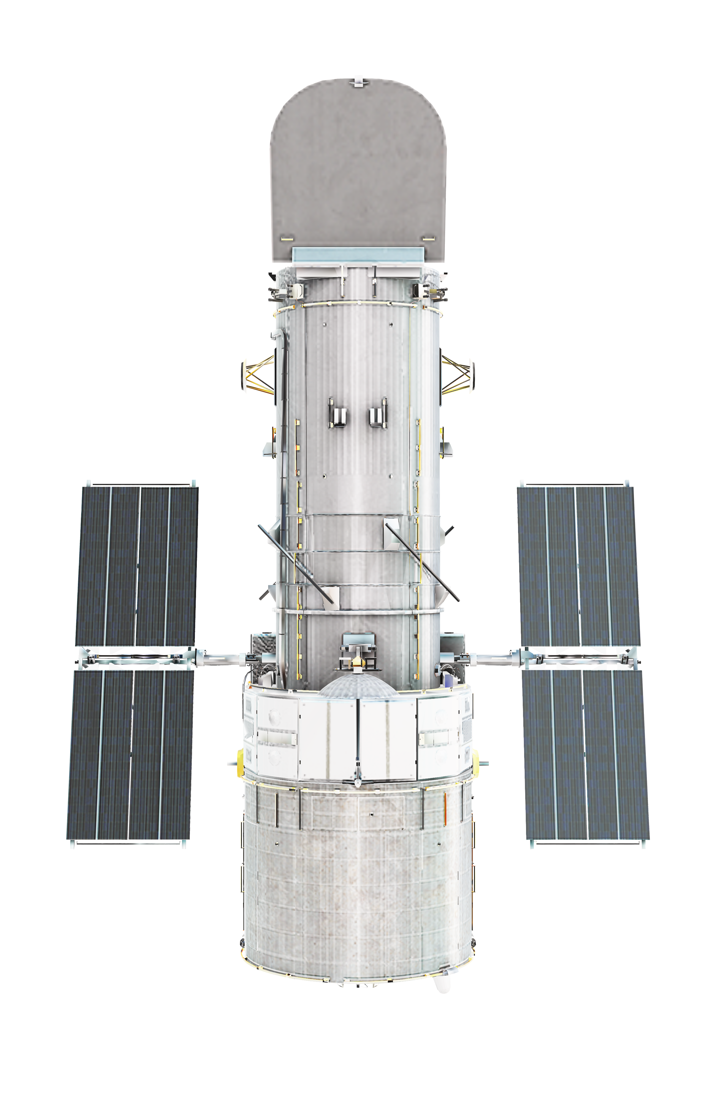
AGANDA
1- The Main Problem
2- TASK1: Data Scrapping And Wraggling
3- TASK2: Data Visulization and Dashboard
4- TASK3: Data Analysis and EDA
5- TASK4: Predective Anaylsis
6- Conclusion & Link

Slide 3
THE MAIN PROBLEM : Summary
Falcon 9 is a rocket made by SpaceX that is used to launch things into space, such as satellites and spacecraft.
🚀 Falcon = the name of the rocket family.
Falcon 9 = a specific SpaceX rocket with 9 engines on its first stage.
SpaceX = the company that develops and operates it.
The main problem is will be working on if the station that have been used for falcon will can be reused or note, using pyhon,
Data anaylising, predictive and reporting in this presentation

Slide 4
THE MAIN PROBLEM : Summary
This project investigates SpaceX Falcon 9 launch data with the main objective of understanding and predicting the successful landing of the rocket's first stage. Because first-stage reusability is an important factor in reducing launch costs, predicting landing success can provide valuable information for evaluating launch feasibility and supporting competitive pricing decisions. The project follows a complete data science workflow, beginning with data collection from the SpaceX API and web scraping, followed by data cleaning and transformation. Exploratory analysis was then performed using Python, SQL, statistical analysis, and interactive visualizations to investigate relationships between landing success and factors such as launch site, payload mass, flight number, orbit, and time. Geographical analysis using Folium and an interactive Plotly Dash dashboard provided additional insight into launch-site performance. Finally, several machine-learning classification models were developed and evaluated to predict first-stage landing outcomes. Overall, the project demonstrates how historical launch data can be transformed into actionable insights and predictive information for future Falcon 9 missions.

Slide 5
THE MAIN PROBLEM : Methodology
The project used a structured end-to-end data science methodology. First, data was collected using the SpaceX REST API and supplemented with web scraping to obtain additional Falcon 9 launch information. The collected data was then cleaned and wrangled, including handling missing values, selecting relevant variables, creating the landing-success target variable, and transforming categorical variables into numerical features suitable for analysis and machine learning.
Next, exploratory data analysis (EDA) was conducted using Python libraries such as Pandas, Matplotlib, and Seaborn, together with SQL/SQLite queries to investigate launch sites, payloads, booster versions, landing outcomes, and historical trends. Statistical and graphical analysis was used to identify relationships between launch characteristics and landing success.
The project then applied interactive visual analytics. Folium was used to map SpaceX launch sites and examine their geographical relationship with coastlines, cities, roads, and other features. A Plotly Dash dashboard was developed to allow users to interactively filter launch sites and payload ranges and explore landing outcomes.
Finally, the project used supervised machine learning classification to predict whether the Falcon 9 first stage would land successfully. Multiple algorithms, including Logistic Regression, Support Vector Machine, Decision Tree, and K-Nearest Neighbors, were trained and evaluated. Hyperparameter tuning was used to improve model performance, and evaluation metrics such as accuracy, F1 score, Jaccard score, and confusion matrices were used to compare predictions. This methodology connects descriptive analysis with predictive modeling and provides a complete framework for understanding Falcon 9 landing performance.

Slide 6
THE MAIN PROBLEM : Key Results
The analysis revealed several important patterns in Falcon 9 landing performance. Landing success increased over time, indicating a clear improvement in the historical success rate of first-stage recovery. The exploratory analysis also showed that launch characteristics such as flight number, launch site, payload mass, and orbit are associated with differences in landing outcomes. Among the launch sites examined, KSC LC-39A showed a high level of landing success, while some orbital categories displayed particularly strong historical success rates. The geographical analysis showed that SpaceX launch sites are positioned close to the coast, while also having proximity to transportation infrastructure such as roads and railways, which is relevant to the operational context of launch activities.
The SQL analysis provided another perspective by aggregating the launch records according to payload, booster version, date, and landing outcome. This made it possible to identify historical patterns that are difficult to see from individual launch records alone. The interactive dashboard further transformed these findings into a practical analytical tool, allowing users to investigate how launch site and payload range relate to successful and unsuccessful outcomes.
For predictive analytics, multiple classification algorithms were trained and compared. The models produced broadly comparable results on the test data, while the Decision Tree showed a slight advantage according to the notebook's model-selection criterion. This indicates that the relationship between launch characteristics and landing outcome can be captured by machine-learning models and used to generate predictions for new launch scenarios. The results should be interpreted as predictions based on historical data rather than guarantees of future landing performance.
Taken together, the project demonstrates that Falcon 9 landing success is not explained by a single variable. Instead, it reflects a combination of mission characteristics, launch location, payload, booster history, orbit, and technological evolution over time. An innovative extension of this work would be to turn the predictive model into a scenario-analysis tool: users could change payload, launch site, orbit, and booster characteristics and examine how the predicted landing outcome changes. This would move the project from simply predicting historical outcomes toward supporting data-driven mission planning and launch-cost analysis.

Slide 7
TASK1: Data Scrapping
Web Scraping — Falcon 9 Launch Data
Send an HTTP request
We used requests.get() to download the Wikipedia page containing Falcon 9 launch information.
Create a BeautifulSoup object
We used BeautifulSoup(response.text, "html.parser") to parse the HTML and make it easier to work with.
Find all tables
We used:
html_tables = soup.find_all("table")
This finds all <table> elements on the webpage.
Find the launch table
We selected the table containing the Falcon 9 launch data and stored it in first_launch_table.
Extract column names
We searched for <th> elements using find_all("th"), then used extract_column_from_header() to get each column name.
Store the column names
We added only non-empty column names to the column_names list.
In simple terms:
Website → Request HTML → BeautifulSoup → Find tables → Find launch table → Extract column names
Link:
https://github.com/Selmabanzema/Data-Science-Capston-Project-/blob/main/jupyter-labs-webscraping.ipynb

Slide 8
TASK1: Data Scrapping Outputs
print(response.content)
b'<!DOCTYPE html>\n<!--[if lt IE 7]> <html class="no-js ie6 oldie" lang="en-US"> <![endif]-->\n<!--[if IE 7]> <html class="no-js ie7 oldie" lang="en-US"> <![endif]-->\n<!--[if IE 8]> <html class="no-js ie8 oldie" lang="en-US">…….
response.status_code
20
Print the page title to verify if the BeautifulSoup object was created properly
<title>List of Falcon 9 and Falcon Heavy launches - Wikipedia</title>
print(column_names)
['Flight No.', 'Date and time ( )', 'Launch site', 'Payload', 'Payload mass', 'Orbit', 'Customer', 'Launch outcome’]
Link:
https://github.com/Selmabanzema/Data-Science-Capston-Project-/blob/main/jupyter-labs-webscraping.ipynb

Slide 9
TASK1: Data Scrapping
Web Scraping — Falcon 9 Launch Data
Send an HTTP request
We used requests.get() to download the Wikipedia page containing Falcon 9 launch information.
Create a BeautifulSoup object
We used BeautifulSoup(response.text, "html.parser") to parse the HTML and make it easier to work with.
Find all tables
We used:
html_tables = soup.find_all("table")
This finds all <table> elements on the webpage.
Find the launch table
We selected the table containing the Falcon 9 launch data and stored it in first_launch_table.
Extract column names
We searched for <th> elements using find_all("th"), then used extract_column_from_header() to get each column name.
Store the column names
We added only non-empty column names to the column_names list.
In simple terms:
Website → Request HTML → BeautifulSoup → Find tables → Find launch table → Extract column names
Link:
https://github.com/Selmabanzema/Data-Science-Capston-Project-/blob/main/jupyter-labs-webscraping.ipynb

Slide 10
TASK1: Data Wraggling
In this exercise, we used data-wrangling techniques to analyze launch data. We used the .value_counts() method to determine the number of launches at each launch site and the number of launches for each orbit, while excluding GTO because it is a transfer orbit. We also counted the different mission outcomes and assigned them to the landing_outcomes variable. Then, we created the landing_class list, assigning 0 to unsuccessful landing outcomes and 1 to successful ones. Finally, we used the Outcome and Orbit columns to determine how many missions successfully landed on a drone ship and how many launches went to geosynchronous orbit.
Link:
https://github.com/Selmabanzema/Data-Science-Capston-Project-/blob/main/labs-jupyter-spacex-Data%20wrangling.ipynb

Slide 11
TASK1: Data Wraggling Example Outputs
df.isnull().sum()/len(df)*100
FlightNumber 0.000000
Date 0.000000
BoosterVersion 0.000000
PayloadMass 0.000000
Orbit 0.000000
LaunchSite 0.000000
df['LaunchSite'].value_counts()
LaunchSite
CCAFS SLC 40 55
KSC LC 39A 22
VAFB SLC 4E 13
Name: count, dtype: int64
bad_outcomes=set(landing_outcomes.keys()[[1,3,5,6,7]])bad_outcomes
{'False ASDS', 'False Ocean', 'False RTLS', 'None ASDS', 'None None'}
Link:
https://github.com/Selmabanzema/Data-Science-Capston-Project-/blob/main/labs-jupyter-spacex-Data%20wrangling.ipynb

Slide 12
TASK2: Complete the EDA with SQL
Our goals is to understand the data and filter and understand is using sqllite codes,
The goal of this analysis was to use SQL queries and SQLite to explore the SpaceX launch dataset and extract meaningful information about launch sites, payloads, booster versions, and landing outcomes. The analysis first loaded the SpaceX data into a database and then used SQL queries to investigate important operational questions. It identified the unique launch sites and examined sites beginning with “CCA,” calculated the total payload mass carried by NASA (CRS) missions, and determined the average payload mass associated with the F9 v1.1 booster version. The analysis also identified the date of the first successful ground-pad landing, examined boosters that successfully landed on drone ships while carrying payloads between 4,000 and 6,000 kg, and calculated the total number of successful and unsuccessful mission outcomes.
A further highlight was the use of more advanced SQL techniques, including subqueries, filtering, aggregation, date extraction, and ranking. The analysis identified booster versions associated with the maximum payload mass and examined 2015 drone-ship landing failures, including the month, booster version, and launch site. It also ranked landing outcomes between June 4, 2010 and March 20, 2017, providing a chronological perspective on the evolution of Falcon 9 landing performance.
Link:
https://github.com/Selmabanzema/Data-Science-Capston-Project-/blob/main/jupyter-labs-eda-sql-coursera_sqllite.ipynb

Slide 13
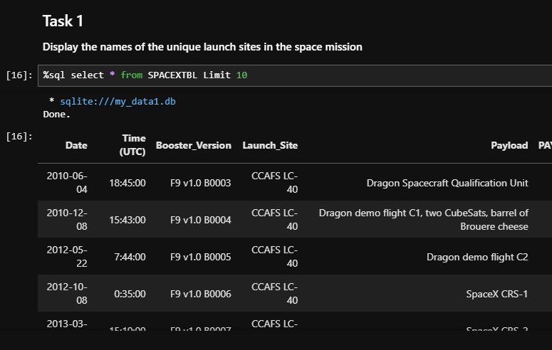
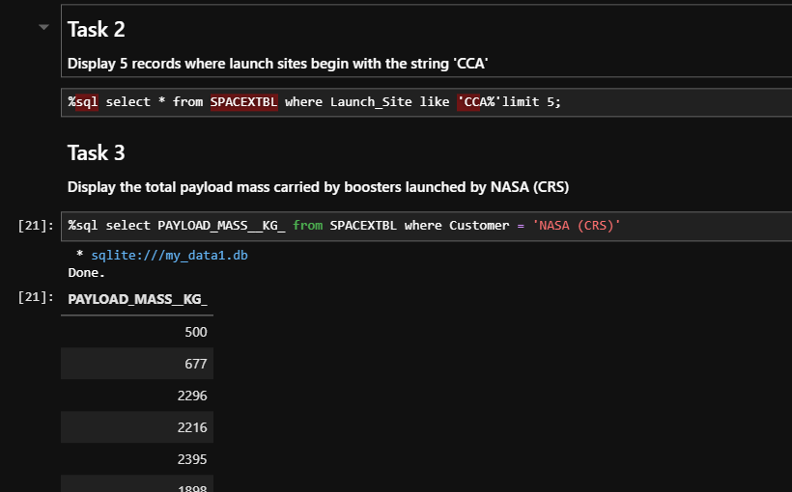
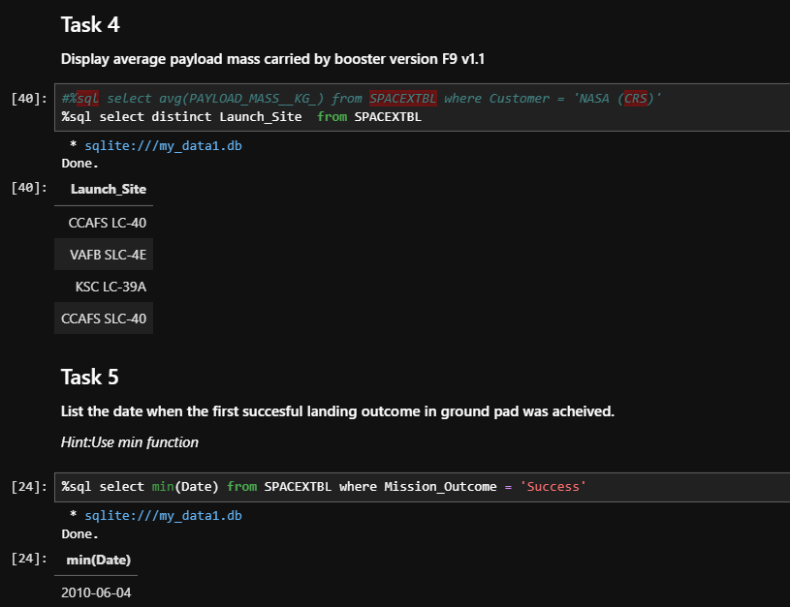
TASK2: Complete the EDA with SQL Example Outputs
Link:
https://github.com/Selmabanzema/Data-Science-Capston-Project-/blob/main/jupyter-labs-eda-sql-coursera_sqllite.ipynb

Slide 14
TASK2: Complete the EDA with SQL Detailed Outputs
Link:
https://github.com/Selmabanzema/Data-Science-Capston-Project-/blob/main/jupyter-labs-eda-sql-coursera_sqllite.ipynb
Display 5 records where launch sites begin with the string 'CCA'
%sql select * from SPACEXTBL where Launch_Site like 'CCA%'limit 5;
Display the total payload mass carried by boosters launched by NASA
%sql select PAYLOAD_MASS__KG_ from SPACEXTBL where Customer = 'NASA (CRS)’
Display average payload mass carried by booster version F9 v1.1
%sql select distinct Launch_Site from SPACEXTBL
List the date when the first succesful landing outcome in ground pad was acheived
%sql select min(Date) from SPACEXTBL where Mission_Outcome = 'Success'

Slide 15
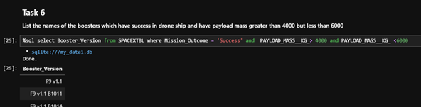
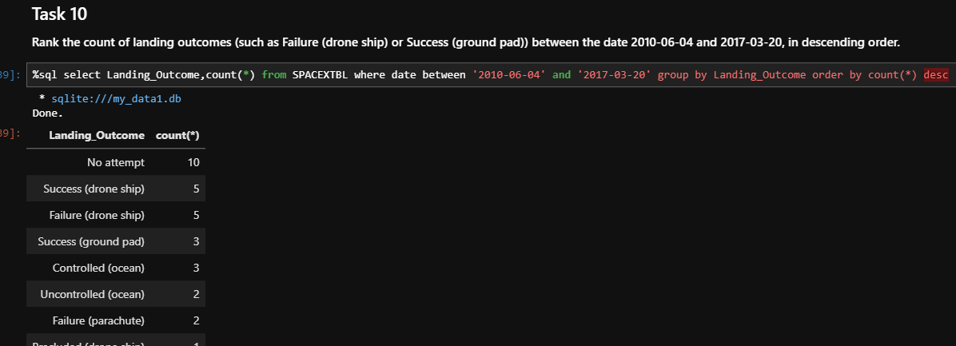
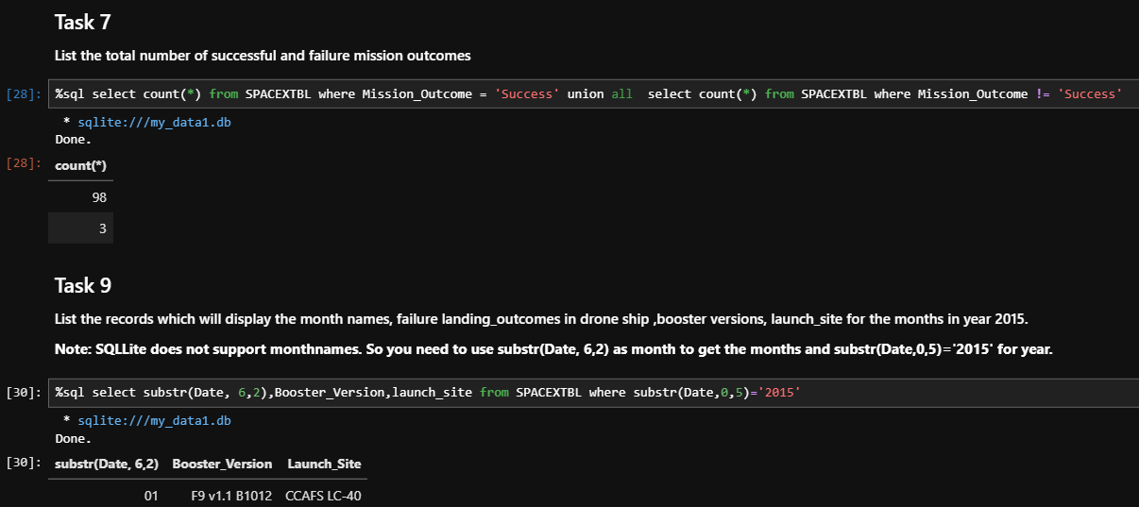
TASK2: Complete the EDA with SQL Detailed Outputs
Link:
https://github.com/Selmabanzema/Data-Science-Capston-Project-/blob/main/jupyter-labs-eda-sql-coursera_sqllite.ipynb

Slide 16
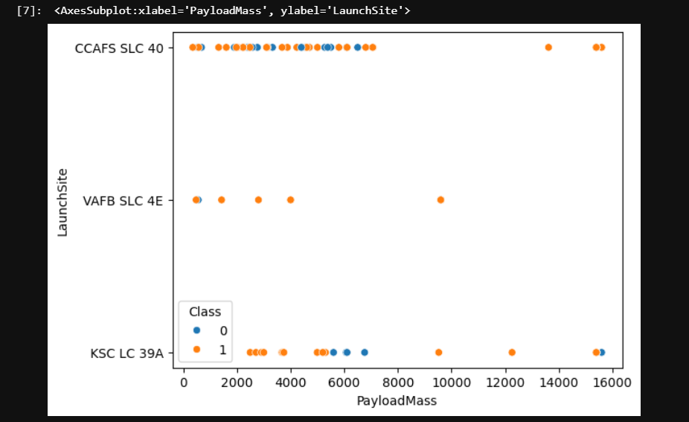
TASK2: EDA with Visualization Lab
The goal of this analysis was to explore and prepare the SpaceX launch dataset for further analysis and machine learning. The dataset was imported and examined using Python, Pandas, Matplotlib, and Seaborn. Visualizations were created to investigate the relationship between Flight Number, Payload Mass, Launch Site, and Class, helping to identify patterns between successful and unsuccessful launches. The analysis also included preparing categorical variables by creating dummy variables and converting numerical columns to the float64 data type. These steps provide a clean and structured dataset for subsequent analysis and predictive modeling. Here is example of what we did:
Link:
https://github.com/Selmabanzema/Data-Science-Capston-Project-/blob/main/edadataviz.ipynb

Slide 17
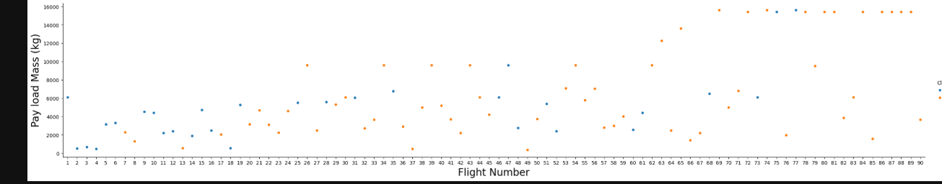
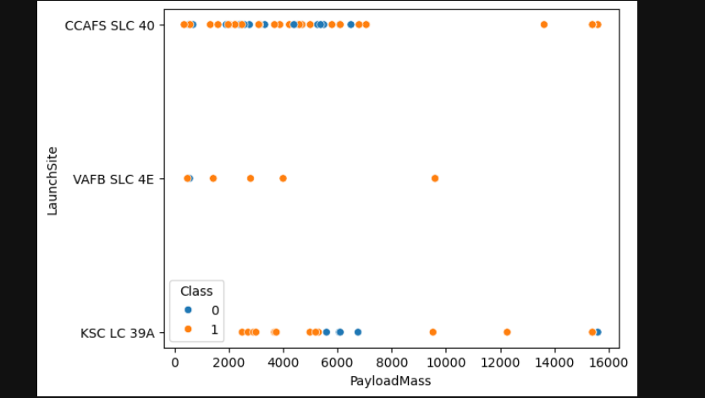
TASK2: EDA with Visualization Lab Example Outputs
sns.catplot(y="PayloadMass", x="FlightNumber", hue="Class", data=df, aspect = 5)plt.xlabel("Flight Number",fontsize=20)plt.ylabel("Pay load Mass (kg)",fontsize=20)plt.show()
sns.scatterplot(x='PayloadMass',y='LaunchSite',data=df,hue='Class’)
Link:
https://github.com/Selmabanzema/Data-Science-Capston-Project-/blob/main/edadataviz.ipynb

Slide 18
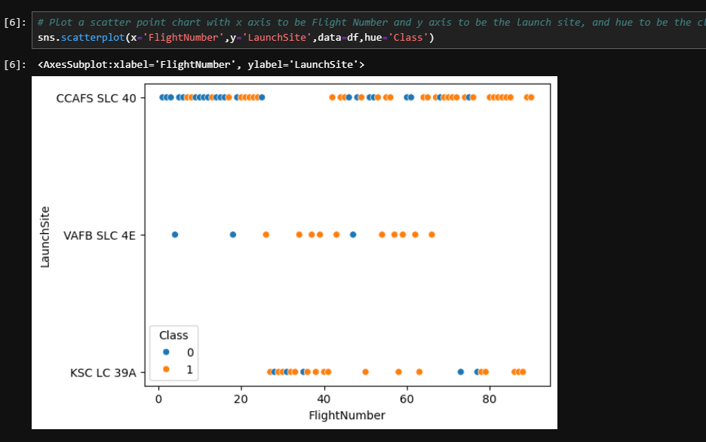
TASK2: EDA with Visualization Lab Example Outputs
Link:
https://github.com/Selmabanzema/Data-Science-Capston-Project-/blob/main/edadataviz.ipynb

Slide 19
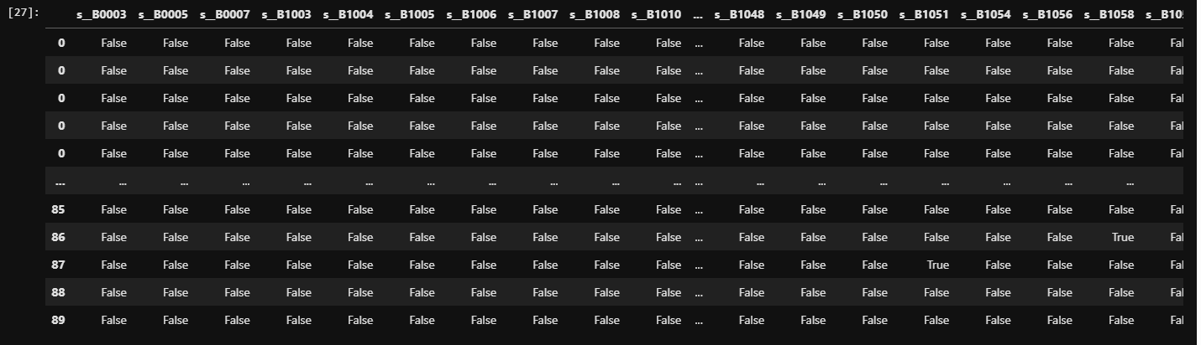
TASK2: EDA with Visualization Lab Example Outputs
Create dummy variables to categorical columns
dh=pd.get_dummies(df['Orbit'],prefix='O_')df=pd.concat((dh,df)
........
Link:
https://github.com/Selmabanzema/Data-Science-Capston-Project-/blob/main/edadataviz.ipynb

Slide 20
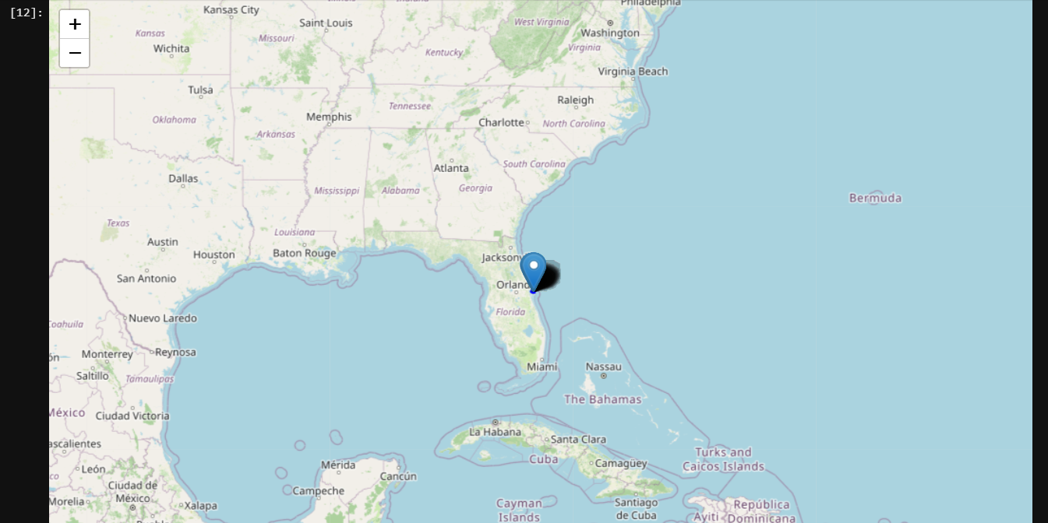
TASK3: EDA with Visualization Lab Folium
The goal of this analysis was to investigate the geographical locations of SpaceX launch sites and identify possible patterns related to launch success. The analysis used Folium to create interactive maps showing the different launch sites and their locations. The launches were then visualized according to their success or failure, allowing the distribution of successful and unsuccessful launches at each site to be examined. The analysis also explored the distances between launch sites and nearby geographical features, such as coastlines, cities, roads, and other points of interest. Overall, the work provides a geographical perspective on SpaceX launch performance and helps identify factors and patterns that may be associated with the location of launch sites.
Here is example of one of the outputs
Link:
https://github.com/Selmabanzema/Data-Science-Capston-Project-/blob/main/lab_jupyter_launch_site_location.ipynb

Slide 21
TASK3: EDA with Visualization Lab Dash
The goal of this project was to create an interactive dashboard for analyzing SpaceX launch records and exploring the factors associated with launch success. The dashboard allows users to select a specific launch site or view data from all sites, with a pie chart showing the number of successful launches or the success and failure rate for a selected site. A payload mass range slider allows users to filter launches based on payload weight, while an interactive scatter plot displays the relationship between payload mass and launch outcome, with different booster categories shown for comparison. Overall, the dashboard provides an interactive way to explore SpaceX launch performance across different launch sites, payload ranges, and booster versions.
For the pie chart, KSC LC-39A
KSC LC-39A recorded 10 successful landings out of 13 launches, corresponding to a success rate of approximately 76.9%. This demonstrates comparatively strong landing performance for this launch site in the dashboard dataset.
For the payload scatter plot,
The payload analysis shows that successful landings occur across different payload masses. The visualization also suggests that payload mass alone does not explain landing success, because outcomes vary across payload ranges and booster categories.
Link:
https://github.com/Selmabanzema/Data-Science-Capston-Project-/blob/main/creating%20a%20dash.py

Slide 22
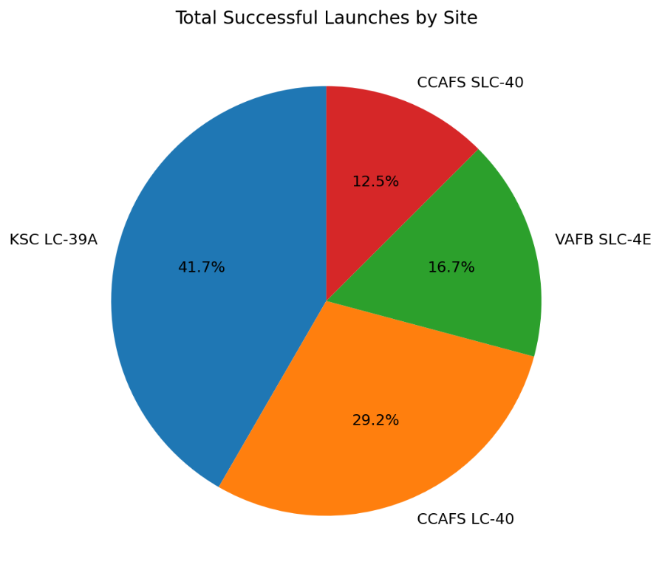
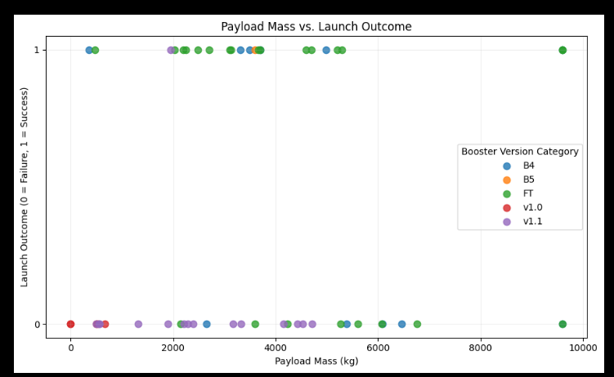
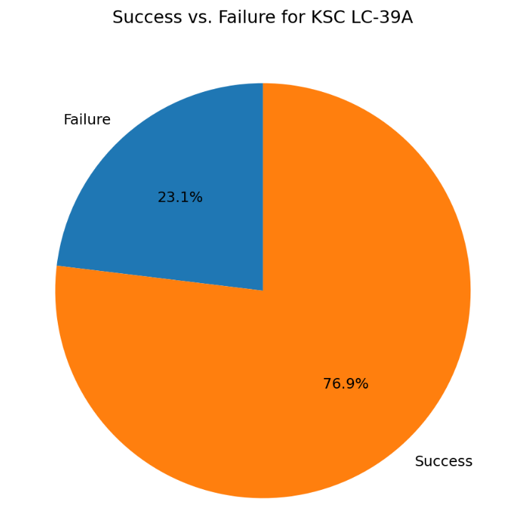
TASK3: EDA with Visualization Lab Dash

Slide 23
TASK4: Predective Anaylsis
Machine Learning Model and Results
The goal of the machine learning stage was to develop a classification model capable of predicting whether the Falcon 9 first stage would successfully land. After preparing the dataset, categorical variables were transformed into numerical features and the data was divided into training and testing sets. Several classification algorithms were then applied, including Logistic Regression, Support Vector Machine (SVM), Decision Tree, and K-Nearest Neighbors (KNN). Hyperparameter tuning was performed using GridSearchCV to identify suitable parameter combinations and improve the predictive performance of each model.
Model Evaluation
The models were evaluated using several complementary metrics rather than relying only on accuracy. Accuracy measured the overall proportion of correct predictions, while the F1 score provided a balance between precision and recall. The Jaccard score measured the similarity between the predicted and actual successful-landing classes, and the confusion matrix provided a more detailed view of correct and incorrect predictions. Comparing these metrics made it possible to examine not only how often each model was correct, but also how effectively it identified successful and unsuccessful landings.
The evaluation shows that machine learning can capture meaningful relationships between launch characteristics and Falcon 9 landing outcomes. The differences between the models demonstrate why model comparison is important: a model with a strong overall accuracy may still produce different types of errors from another model. The tuned models therefore provide a more reliable basis for selecting the final prediction approach than using default model settings alone.
Link:
https://github.com/Selmabanzema/Data-Science-Capston-Project-/blob/main/SpaceX_Machine%20Learning%20Prediction_Part_5%20(1).ipynb

Slide 24
TASK4: Predective Anaylsis
Best Model Application
After comparing the trained models, the model selected from the notebook can be applied to new, previously unseen launch conditions. Given information such as launch site, payload characteristics, orbit, booster configuration, and other engineered features, the model produces a predicted landing outcome. This transforms the analysis from simply describing historical SpaceX launches into a practical predictive tool.
The most valuable aspect of this application is its potential decision-support role. Before a future launch, the model could provide an additional data-driven estimate of first-stage landing success based on characteristics similar to previous missions. This could help analysts investigate which combinations of launch conditions are associated with higher or lower predicted success.
Link:
https://github.com/Selmabanzema/Data-Science-Capston-Project-/blob/main/SpaceX_Machine%20Learning%20Prediction_Part_5%20(1).ipynb

Slide 25
TASK4: Predective Anaylsis
Best Model Application
After comparing the trained models, the model selected from the notebook can be applied to new, previously unseen launch conditions. Given information such as launch site, payload characteristics, orbit, booster configuration, and other engineered features, the model produces a predicted landing outcome. This transforms the analysis from simply describing historical SpaceX launches into a practical predictive tool.
The most valuable aspect of this application is its potential decision-support role. Before a future launch, the model could provide an additional data-driven estimate of first-stage landing success based on characteristics similar to previous missions. This could help analysts investigate which combinations of launch conditions are associated with higher or lower predicted success.
Link:
https://github.com/Selmabanzema/Data-Science-Capston-Project-/blob/main/SpaceX_Machine%20Learning%20Prediction_Part_5%20(1).ipynb

Slide 26
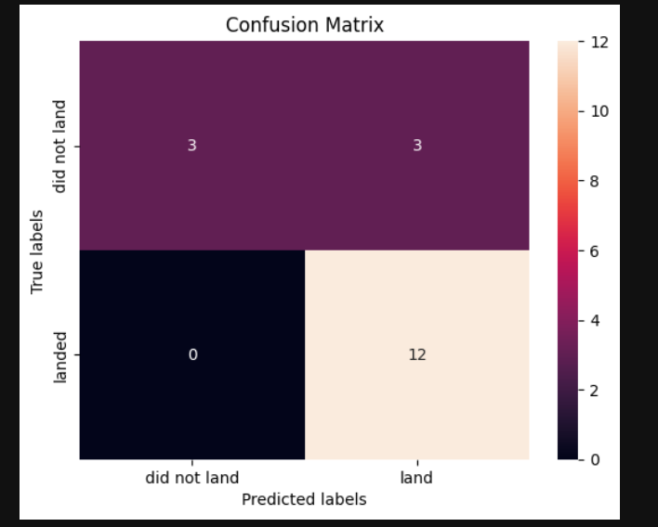
TASK4: Predective Anaylsis Outpusta
1- Logistic regression:
1- we have worked on it and the score is : 1
The conffisoun matrix :
Link:
https://github.com/Selmabanzema/Data-Science-Capston-Project-/blob/main/SpaceX_Machine%20Learning%20Prediction_Part_5%20(1).ipynb

Slide 27
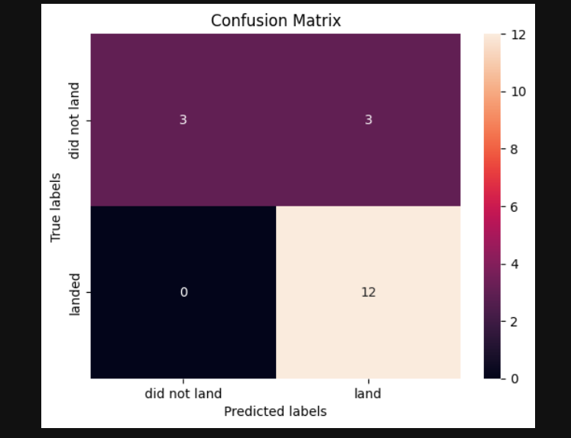
TASK4: Predective Anaylsis Outpusta
1- SVM:
tuned hpyerparameters :(best parameters) {'C': 0.03162277660168379, 'gamma': 0.001, 'kernel': 'linear'}
accuracy : 0.8342857142857142 , the photo for the confusion matrix:
Link:
https://github.com/Selmabanzema/Data-Science-Capston-Project-/blob/main/SpaceX_Machine%20Learning%20Prediction_Part_5%20(1).ipynb

Slide 28
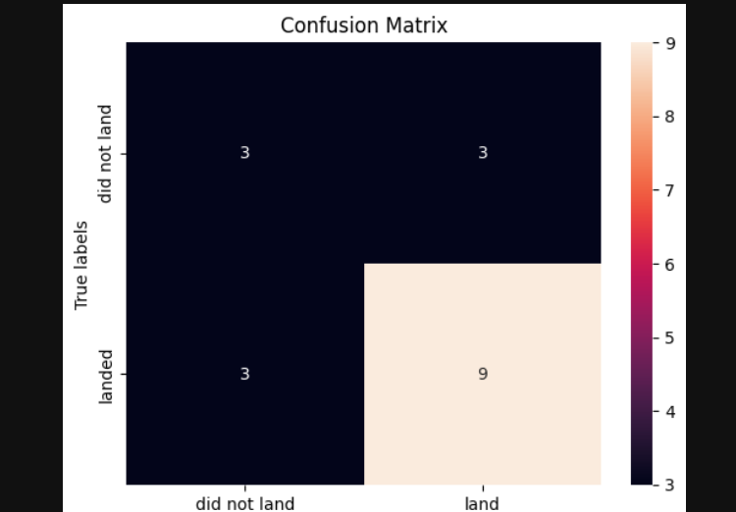
TASK4: Predective Anaylsis Outpusta
1- TREE:
tuned hpyrparameters :(best parameters) {'criterion': 'entropy', 'max_depth': 10, 'max_features': 'sqrt', 'min_samples_leaf': 1, 'min_samples_split': 5, 'splitter': 'best'}
accuracy : 0.8607142857142858
, the photo for the confusion matrix:
Link:
https://github.com/Selmabanzema/Data-Science-Capston-Project-/blob/main/SpaceX_Machine%20Learning%20Prediction_Part_5%20(1).ipynb

Slide 29
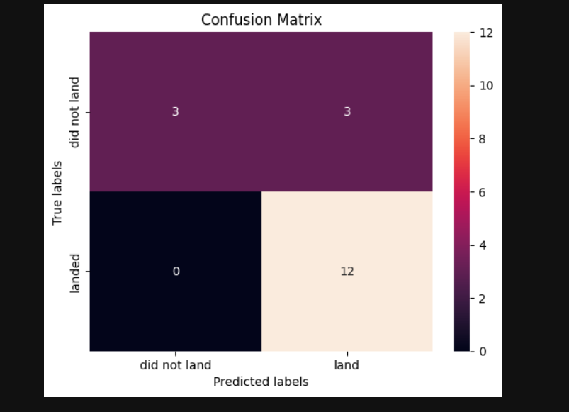
TASK4: Predective Anaylsis Outpusta
1- knn:
tuned hpyerparameters :(best parameters) {'algorithm': 'auto', 'n_neighbors': 8, 'p': 1}
accuracy : 0.8609523809523811
, the photo for the confusion matrix:
Link:
https://github.com/Selmabanzema/Data-Science-Capston-Project-/blob/main/SpaceX_Machine%20Learning%20Prediction_Part_5%20(1).ipynb

Slide 30
TASK4: Predective Anaylsis Outpusta
The Best model is KNN
Link:
https://github.com/Selmabanzema/Data-Science-Capston-Project-/blob/main/SpaceX_Machine%20Learning%20Prediction_Part_5%20(1).ipynb

Slide 31
CONCLUSİON AND INSIGHT
Conclusion and Innovative Insight
Overall, the machine learning analysis demonstrates how historical SpaceX launch data can be transformed into a predictive framework for Falcon 9 landing success. The project combines data preparation, feature engineering, multiple classification algorithms, hyperparameter optimization, and model evaluation to move from raw launch records toward predictive insight.
A particularly interesting insight is that the prediction should not be interpreted as a simple question of whether a rocket is “good” or “bad.” Landing success is influenced by a combination of operational factors, meaning that the same payload mass or booster type can have different implications under different launch conditions. This suggests a more innovative direction for future work: instead of using the model only as a yes/no predictor, it could be developed into a mission-risk analysis tool that estimates the probability of landing success under different combinations of launch site, payload, orbit, and booster characteristics. Such a system could allow analysts to compare hypothetical mission configurations before launch and identify conditions associated with different predicted outcomes.
The final value of the project therefore lies not only in predicting a landing outcome, but in demonstrating how machine learning can convert historical launch data into actionable, scenario-based insights for future missions.
The Hole Project Link
https://github.com/Selmabanzema/Data-Science-Capston-Project-

